Slide 1
Basic Programming with java
Week 1

Slide 2
Basic syntax
Basic programming with java
class CobaAja{
public static void main(String[] args){
String nama = "Angga";
String nomorTlp="08170998245";
System.out.println(nama);
System.out.println("Nama Saya :"+nama);
System.out.println(nomorTlp);
}
}
public class MyFirstJavaProgram {
public static void main(String []args) {
System.out.println("Hello World"); // prints Hello World
}
}
Nama class menggunakan PascalCase
Apa yg dimaksud dengan main method
Method menggunakan camelCase dan verb
Nama variable menggunakan camelCase

Slide 3
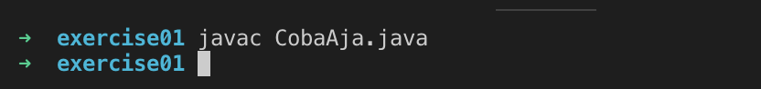
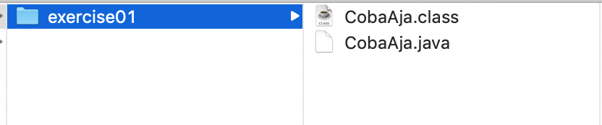
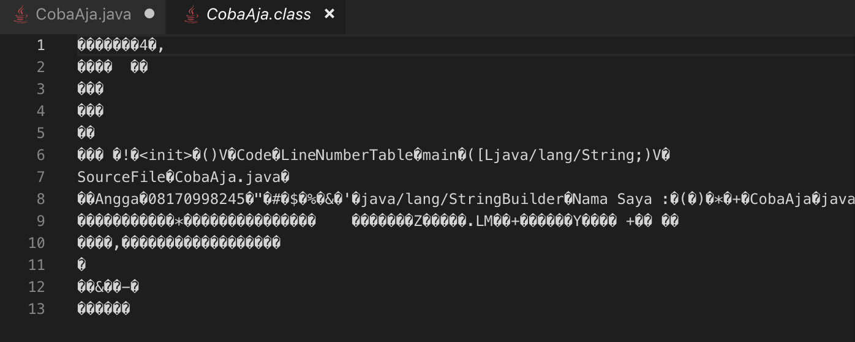
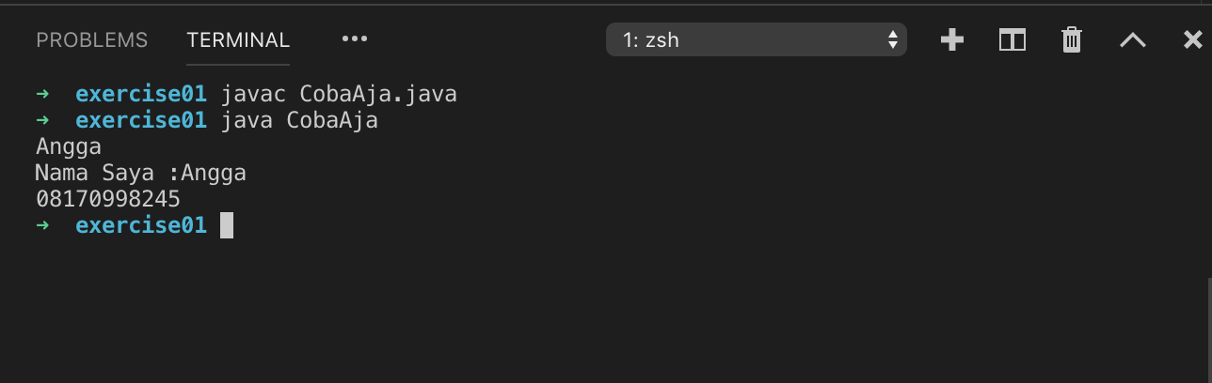
Compile & run
Basic programming with java
Javac melakukan proses compile menjadi executable binary
Executable binary yg dihasilkan terdapat pada file dengan extention .class
Perintah java untuk menjalankan executable binary / .class nya

Slide 4
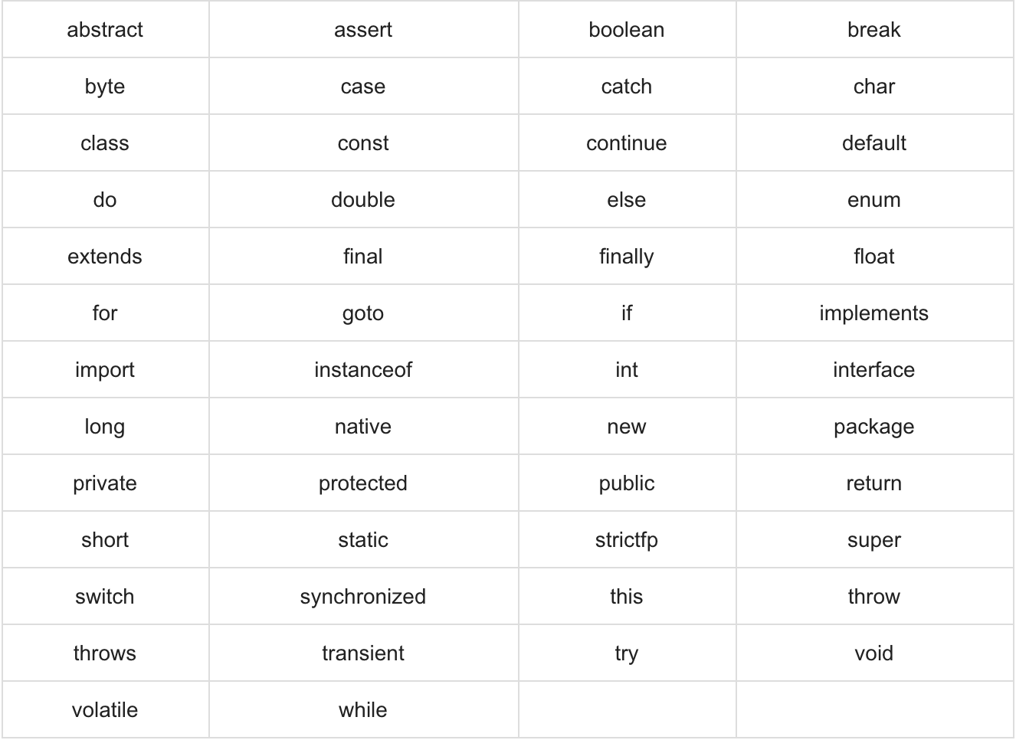
Java Keywords
Basic programming with java
Apa jadi nya kalau kita mendeklarasikan variable dengan nama yg sama dengan salah satu keywords

Slide 5
Variables
Basic programming
Variables
Local Variables
Static Variables
Instance Variables
Untuk basic programming kita focus menggunakan local variable

Slide 6
Primitive data type
Basic programming with java
byte pasti berisi bilangan bulat dengan size -128 sd 127
short bilangan bulat dengan size -32768 sd 32767
int bilangan bulat dengan size -2147483648 sd 2147483647
long bilangan bulat dengan size -2^63 sd 2^62
float single-precision 32-bit IEEE 754 floating point
double double-precision 64-bit IEEE 754 floating point
boolean…… are you kidding me?
char single 16-bit Unicode character

Slide 7
Non-Primitive data types (Reference Data Types)
Basic programming with java
Hampir semua tipe data esperti String, Integer (yg berawalan hurry besar) adalah type data Reference
Mereka memiliki Class Object nya
Array
Collections dan turunan nya

Slide 8
Operators
Basic programming with java
Arithmetic Operators
+ - x / % ++ --
Bitwise Operators
Biasanya dipakai ole kalangan pembuat algorithma encryptor
Relational
<, >, ==, <=, >=, != , menhasilkan boolean
Logical Operators
&&, ||, !
Assignment Operators
+=, -=, *=, /=

Slide 9
Conditions
Basic programming with java

Slide 10
Array
Text

Slide 11
Loop
Basic programming with java
Java hanya memiliki 3 tipe Loop
For
While
Do-while

Slide 12
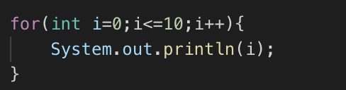
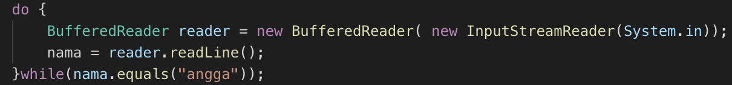
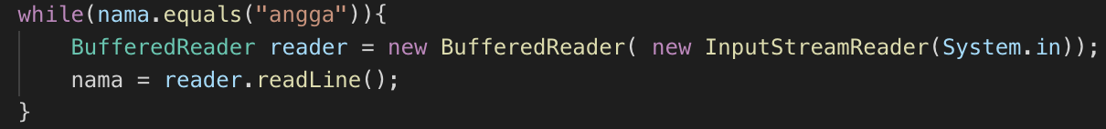
Loop
Basic programming with java
Initial
Condition
Iteration
Apa kah fungsi 2 statement ini?
Break
Continue

Slide 13
Object oriented programming

Slide 14
Class to an object
Text

Slide 15
Text
The keyword is “BLUEPRINT”
Angga Raditya

Slide 16
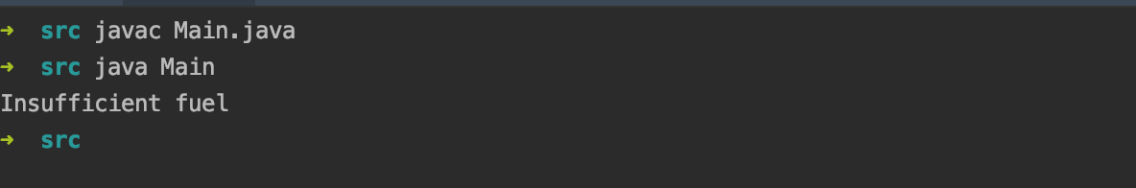
Class, Object, constructor
Text
public class Car {
private String colour;
public Boolean isStart;
private Integer fuel;
public Car(String colour){
this.colour = colour;
this.fuel = 0;
}
public void fillFuel(int fuel){
this.fuel = this.fuel + fuel;
}
public void engineStart(){
if(this.fuel>0){
System.out.println("Brum brum");
} else {
System.out.println("Insufficient fuel");
}
}
public String print() {
return "Car{" +
"colour='" + colour + '\'' +
", isStart=" + isStart +
", fuel=" + fuel +
'}';
}
}
import com.enigma.model.Car;
import java.io.IOException;
public class Main {
public static void main(String[] args) throws IOException {
Car toyotaInova = new Car("Yellow");
toyotaInova.engineStart();
}
}

Slide 17
Access modifier
Text
Class:
Cannot be private
Cannot be protected
Should be public
It can be final, but………
Public
Private
Protected
Final
Static
Should choose only 1
Attribute:
It can be public
Can be private
Can be protected
It can be final, but need to initialised
Can be static, if ….
Method:
All of them, but of course you should choose between public, private and protected

Slide 18
OOP
Text
OOP
Encapsulation
Polymorphism
Inheritance

Slide 19
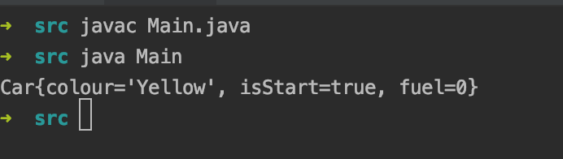
Encapsulation
Text
public class Car {
private String colour;
public Boolean isStart;
private Integer fuel;
public Car(String colour){
this.colour = colour;
this.fuel = 0;
}
public void fillFuel(int fuel){
this.fuel = this.fuel + fuel;
}
public void engineStart(){
if(this.fuel>0){
System.out.println("Brum brum");
} else {
System.out.println("Insufficient fuel");
}
}
public String print() {
return "Car{" +
"colour='" + colour + '\'' +
", isStart=" + isStart +
", fuel=" + fuel +
'}';
}
}
public static void main(String[] args) throws IOException {
Car toyotaInova = new Car("Yellow");
toyotaInova.isStart=true;
System.out.println(toyotaInova.print());
}
Watch
Direct access
The funny part, engine start but no fuel. It doesn’t make sense. It happens because the direct access attribute

Slide 20
Encapsulation
Text

Slide 21
OOP
Text
OOP
Encapsulation
Polymorphism
Inheritance

Slide 22
Inheritance
Text
public class Rectangle {
protected Double length;
protected Double width;
public Rectangle(Double length, Double width){
this.length = length;
this.width = width;
}
public Double getSurface(){
return length*width;
}
Double getRound(){
return 2*(length+width);
}
public String print() {
return "Rectangle{" +
"length=" + length +
", width=" + width +
", round="+ getRound() +
", surface="+ getSurface() +
'}';
}
}
public class Block extends Rectangle {
private Double height;
public Double getVolume(){
return this.length*this.width*this.height;
}
public Block(Double length, Double width, Double height){
super(length,width);
this.height=height;
}
@Override
public Double getSurface(){
return 2*(this.length*this.width)+
2*(this.length*this.height)+
2*(this.width*this.height);
}
public String print() {
return "Block{ length="+this.length+
", width="+this.width+
", height="+this.height+
", surface="+getSurface()+
", volume="+getRound()+"}";
}
}

Slide 23
Inheritance
Text
It will inherit attribute
It inherit method
The method can be override
You can do Parent object = new Child();

Slide 24
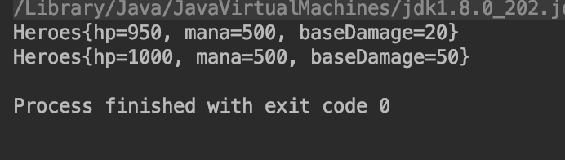
Object Interaction
Text
public class Heroes {
private String name;
private Integer hp;
private Integer mana;
private Integer baseDamage;
private Skill skill1;
public Heroes(Integer hp, Integer mana, Integer baseDamage) {
this.hp = hp;
this.mana = mana;
this.baseDamage = baseDamage;
}
public void attack(Heroes heroes) {
heroes.getHit(this.baseDamage);
}
public void getHit(Integer damage) {
this.hp = this.hp-damage;
}
public String print() {
return "Heroes{" +
"hp=" + hp +
", mana=" + mana +
", baseDamage=" + baseDamage +
'}';
}
}
public class Main {
public static void main(String[] args) throws IOException {
Heroes gatotKaca = new Heroes(1000,500, 20);
Heroes saitama = new Heroes(1000,500,50);
saitama.attack(gatotKaca);
System.out.println(gatotKaca.print());
System.out.println(saitama.print());
}
}

Slide 25
OOp
Text
OOP
Encapsulation
Polymorphism
Inheritance
Abstractions

Slide 26
Polymorphism
Text
public class Heroes {
public String name;
protected Integer hp;
protected Integer mana;
protected Integer baseDamage;
protected Integer attackSpeed;
public Heroes(String name, Integer hp, Integer mana, Integer baseDamage, Integer attackSpeed) {
this.name = name;
this.hp = hp;
this.mana = mana;
this.baseDamage = baseDamage;
this.attackSpeed = attackSpeed;
}
public void attack(Heroes heroes) {
heroes.getHit(this.baseDamage);
}
public void getHit(Integer damage) {
this.hp = this.hp-damage;
}
public String print() {
return "Heroes{" +
"hp=" + hp +
", mana=" + mana +
", baseDamage=" + baseDamage +
'}';
}
}

Slide 27
polymorphism
Text
public class TankerHeroes extends Heroes{
public TankerHeroes(String name, Integer hp, Integer mana, Integer damage, Integer attackspeed){
super(name,hp,mana,damage, attackspeed);
this.hp = this.hp + 300;
}
}
public class AssasinHeroes extends Heroes {
public AssasinHeroes(String name, Integer hp, Integer mana, Integer damage, Integer attackSpeed){
super(name, hp,mana,damage, attackSpeed);
this.attackSpeed = this.attackSpeed +100;
}
}
public class MageHero extends Heroes{
public MageHero(String name, Integer hp, Integer mana, Integer damage, Integer attackSpeed){
super(name, hp,mana,damage, attackSpeed);
this.mana = this.mana + 300;
}
}

Slide 28
OOP
Text
OOP
Encapsulation
Polymorphism
Inheritance
Abstractions

Slide 29
Abstractions
Text
public class Rectangle extends Shape{
protected Double length;
protected Double width;
public Rectangle(Double length, Double width){
this.length = length;
this.width = width;
}
@Override
public Double getSurface(){
return length*width;
}
@Override
Double getRound(){
return 2*(length+width);
}
public String print() {
return "Rectangle{" +
"length=" + length +
", width=" + width +
", round="+ getRound() +
", surface="+ getSurface() +
'}';
}
}
public class Circle extends Shape {
public Integer r;
private final Double pi=3.14;
@Override
public Double getSurface(){
Double surface = pi*r*r;
return surface;
}
@Override
public Double getRound(){
Double round = pi*r*2;
return round;
}
public Double getHalfSurface(){
return getSurface()/2;
}
public Double getHalfRound(){
return getRound()/2;
}
public String print() {
return "Circle{" + "r=" + r +
", pi=" + pi +
", surface = "+getSurface()+
", round = "+getRound()+'}';
}
}
public abstract class Shape {
abstract Double getRound();
abstract Double getSurface();
}

Slide 30
Abstractions
Text
Must be declare with abstract keywords
It can have abstract or non abstract method
Cannot be create direct object

Slide 31
Interface
Text
public class Heroes {
public String name;
protected Integer hp;
protected Integer mana;
protected Integer baseDamage;
protected Integer attackSpeed;
public Heroes(String name, Integer hp, Integer mana, Integer baseDamage, Integer attackSpeed) {
this.name = name;
this.hp = hp;
this.mana = mana;
this.baseDamage = baseDamage;
this.attackSpeed = attackSpeed;
}
public void attack(Heroes heroes) {
heroes.getHit(this.baseDamage);
}
public void getHit(Integer damage) {
this.hp = this.hp-damage;
}
public String print() {
return "Heroes{" +
"hp=" + hp +
", mana=" + mana +
", baseDamage=" + baseDamage +
'}';
}
}
It can hit only a Hero

Slide 32
Interface
Text
Tower
Heroes
Heroes
Soldier

Slide 33
Interface
Text
public class Heroes implements HitAble {
public String name;
protected Integer hp;
protected Integer mana;
protected Integer baseDamage;
protected Integer attackSpeed;
public Heroes(String name, Integer hp, Integer mana, Integer baseDamage, Integer attackSpeed) {
this.name = name;
this.hp = hp;
this.mana = mana;
this.baseDamage = baseDamage;
this.attackSpeed = attackSpeed;
}
public void attack(HitAble hitAble) {
hitAble.getHit(this.baseDamage);
}
@Override
public void getHit(Integer damage) {
this.hp = this.hp-damage;
}
public String print() {
return "Heroes{" +
"hp=" + hp +
", mana=" + mana +
", baseDamage=" + baseDamage +
'}';
}
}
public interface HitAble {
public void getHit(Integer damage);
}
Now it can hit whatever is hit able

Slide 34
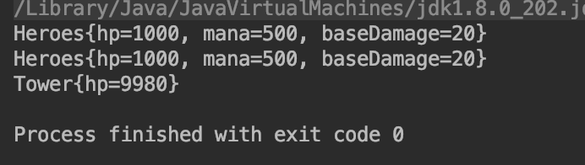
Interface
Text
public class Tower implements HitAble{
Integer hp;
public Tower(Integer hp){
this.hp = hp;
}
@Override
public void getHit(Integer damage) {
this.hp = this.hp - damage;
}
public String print() {
return "Tower{" +
"hp=" + hp +
'}';
}
}
public class Main {
public static void main(String[] args) throws IOException {
Heroes gatotKaca = new Heroes("Gatot Kaca",1000,500, 20, 10);
Heroes saitama = new Heroes("Saitama",1000,500, 20, 10);
Tower tower = new Tower(10000);
saitama.attack(tower);
System.out.println(gatotKaca.print());
System.out.println(saitama.print());
System.out.println(tower.print());
}
}

Slide 35
Object value - equals & Hashcode

Slide 36
Text
It will be easier using Collections frameworks, when we know how the object works
Angga Raditya

Slide 37
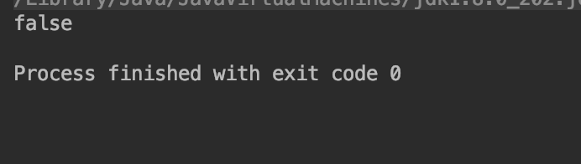
Object value
Text
public class Circle extends Shape {
private Integer r;
private final Double pi=3.14;
public Circle(Integer r) {
this.r = r;
}
@Override
public Double getSurface(){
Double surface = pi*r*r;
return surface;
}
@Override
public Double getRound(){
Double round = pi*r*2;
return round;
}
public String print() {
return "Circle{" + "r=" + r +
", pi=" + pi +
", surface = "+getSurface()+
", Class = "+getClass()+
", round = "+getRound()+'}';
}
}
public static void main(String[] args) throws IOException, InterruptedException {
Circle object = new Circle(10);
System.out.println(object.equals(new Circle(10)));
}

Slide 38
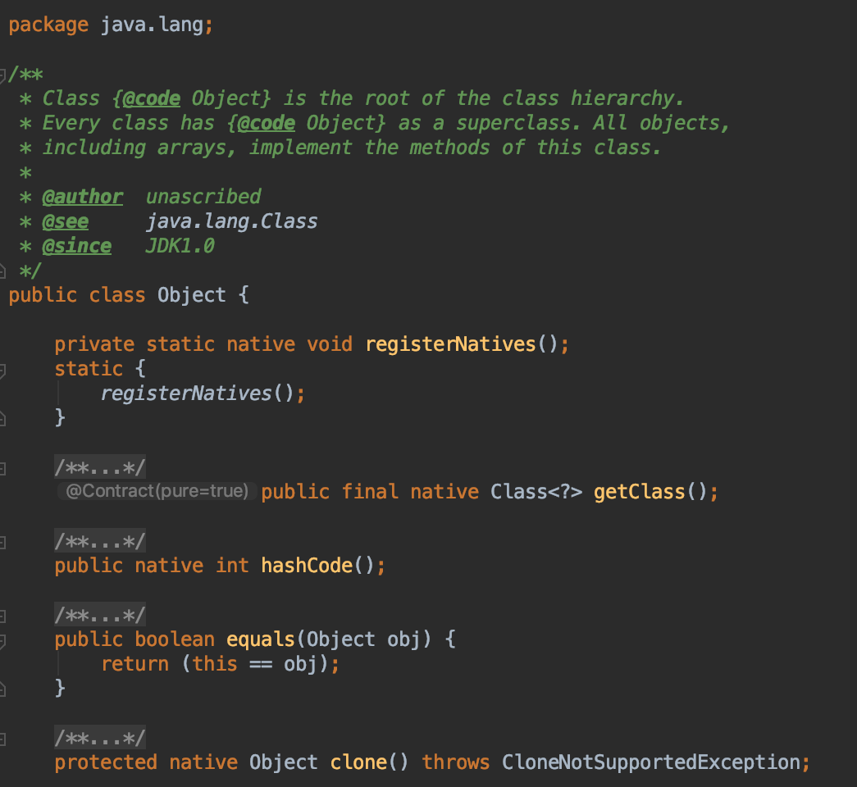
Object value - EQUALS & HASHCODE
Text
It only compare the address

Slide 39
Text
We must define what values make an object unique
Angga Raditya

Slide 40
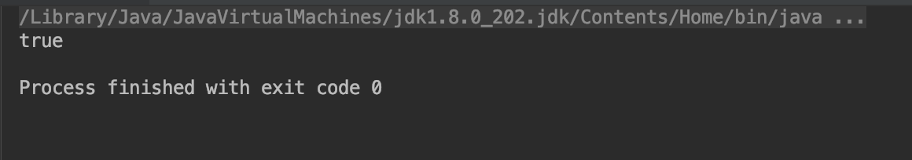
Object value - EQUALS & HASHCODE
Text
public class Circle extends Shape {
private Integer r;
private final Double pi=3.14;
public Circle(Integer r) {
this.r = r;
}
@Override
public Double getSurface(){
Double surface = pi*r*r;
return surface;
}
@Override
public Double getRound(){
Double round = pi*r*2;
return round;
}
@Override
public boolean equals(Object o) {
if (this == o) return true;
if (o == null || getClass() != o.getClass()) return false;
Circle circle = (Circle) o;
return Objects.equals(r, circle.r);
}
public String print() {
return "Circle{" + "r=" + r +
", pi=" + pi +
", surface = "+getSurface()+
", Class = "+getClass()+
", round = "+getRound()+'}';
}
}
public class Main {
public static void main(String[] args) throws IOException, InterruptedException {
Circle object = new Circle(10);
System.out.println(object.equals(new Circle(10)));
}
}
Now it returns the “r” comparison. “r" became the unique value of circle
May be in this case using “r” as a unique value is less relevant. But it will start to make sense when we using Collections Framework

Slide 41
collections

Slide 42
Collections
Text
The Interfaces: Set, List, Queue, Deque
The Class : Arraylist, Vector, LinkedList, HashSet, etc…

Slide 44
Collections:
Set-hashset

Slide 45
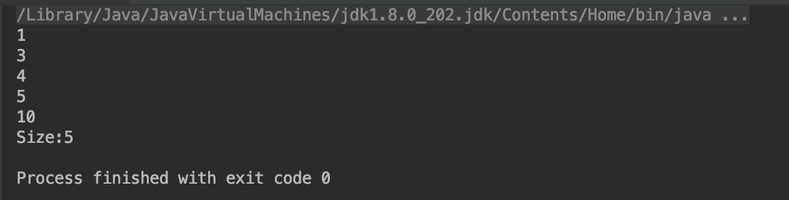
Set - HashSet using value data type
Text
public class Main {
public static void main(String[] args) throws IOException, InterruptedException {
Set<Integer> integerSet = new HashSet<>();
integerSet.add(10);
integerSet.add(5);
integerSet.add(1);
integerSet.add(1);
integerSet.add(1);
integerSet.add(3);
integerSet.add(4);
for (Integer nilai: integerSet) {
System.out.println(nilai);
}
System.out.println("Size:"+integerSet.size());
}
}
Where the others “1” ?????

Slide 46
Text
SEt in Bahasa means “HIMpunan”
Angga Raditya

Slide 47
Set - Hashset
Text
S
3
1
10
5
4

Slide 48
Set - HashSET
Text
Each element in set is not indexed, obviously because order is unnecessary in set.
It contains unique element only
It will use the “HashCode()” as unique value indicator
It can store null values;

Slide 49
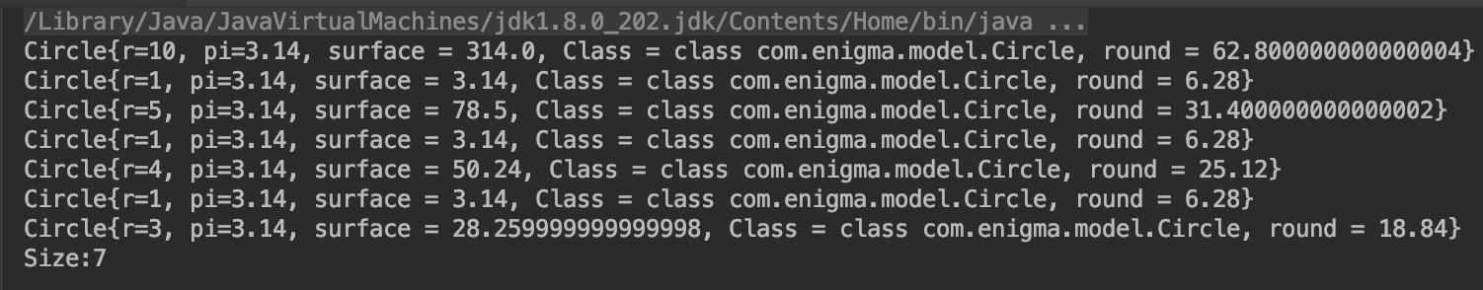
Set - hashSET Using Object
public class Main {
public static void main(String[] args) throws IOException, InterruptedException {
Set<Circle> circleSet = new HashSet<>();
circleSet.add(new Circle(10));
circleSet.add(new Circle(5));
circleSet.add(new Circle(1));
circleSet.add(new Circle(1));
circleSet.add(new Circle(1));
circleSet.add(new Circle(3));
circleSet.add(new Circle(4));
for (Circle circle: circleSet) {
System.out.println(circle.print());
}
System.out.println("Size:"+circleSet.size());
}
}
public class Circle extends Shape {
private Integer r;
private final Double pi=3.14;
public Circle(Integer r) {
this.r = r;
}
@Override
public Double getSurface(){
Double surface = pi*r*r;
return surface;
}
@Override
public Double getRound(){
Double round = pi*r*2;
return round;
}
@Override
public boolean equals(Object o) {
if (this == o) return true;
if (o == null || getClass() != o.getClass()) return false;
Circle circle = (Circle) o;
return Objects.equals(r, circle.r);
}
public String print() {
return "Circle{" + "r=" + r +
", pi=" + pi +
", surface = "+getSurface()+
", Class = "+getClass()+
", round = "+getRound()+'}';
}
}
Duplications still occurs

Slide 50
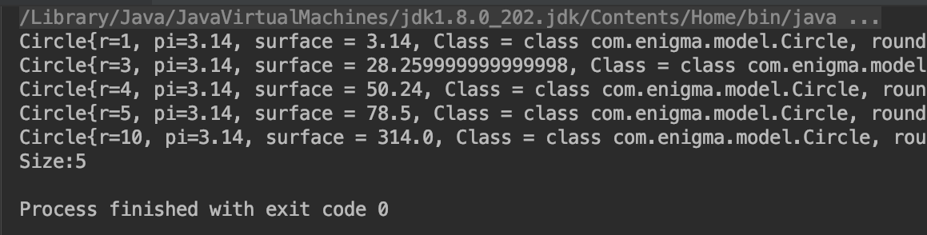
Set - hashSET Using Object
public class Main {
public static void main(String[] args) throws IOException, InterruptedException {
Set<Circle> circleSet = new HashSet<>();
circleSet.add(new Circle(10));
circleSet.add(new Circle(5));
circleSet.add(new Circle(1));
circleSet.add(new Circle(1));
circleSet.add(new Circle(1));
circleSet.add(new Circle(3));
circleSet.add(new Circle(4));
for (Circle circle: circleSet) {
System.out.println(circle.print());
}
System.out.println("Size:"+circleSet.size());
}
}
public class Circle extends Shape {
private Integer r;
private final Double pi=3.14;
public Circle(Integer r) {
this.r = r;
}
@Override
public Double getSurface(){
Double surface = pi*r*r;
return surface;
}
@Override
public Double getRound(){
Double round = pi*r*2;
return round;
}
@Override
public boolean equals(Object o) {
if (this == o) return true;
if (o == null || getClass() != o.getClass()) return false;
Circle circle = (Circle) o;
return Objects.equals(r, circle.r);
}
@Override
public int hashCode() {
return Objects.hash(r);
}
public String print() {
return "Circle{" + "r=" + r +
", pi=" + pi +
", surface = "+getSurface()+
", Class = "+getClass()+
", round = "+getRound()+'}';
}
}
Add hashcode()
The duplications now gone

Slide 51
Text
Now you know what Hashcode is?
Angga Raditya

Slide 52
Collections:
List-Arraylist

Slide 53
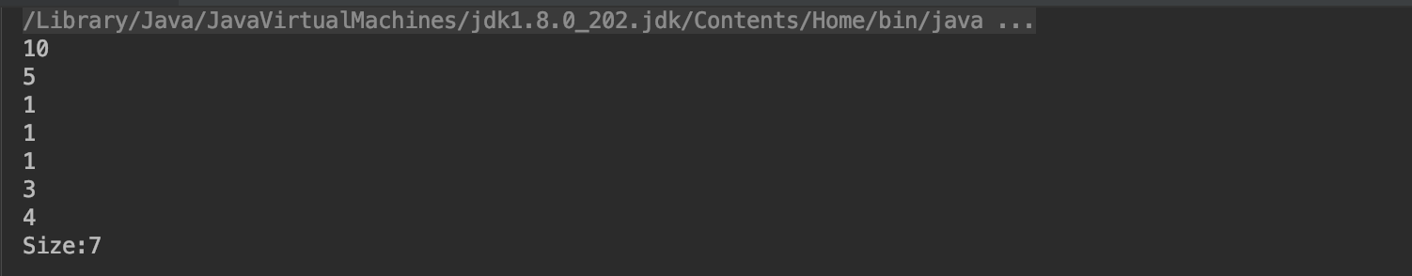
List - Array List
Text
public class Main {
public static void main(String[] args) throws IOException, InterruptedException {
List<Integer> integerList = new ArrayList<>();
integerList.add(10);
integerList.add(5);
integerList.add(1);
integerList.add(1);
integerList.add(1);
integerList.add(3);
integerList.add(4);
for (Integer nilai: integerList) {
System.out.println(nilai);
}
System.out.println("Size:"+integerList.size());
}
}
Duplications

Slide 54
List - ARRAYLIST
Text
Element indexed.
It can contains duplicate element
It will use the “equals()” as unique value indicator

Slide 55
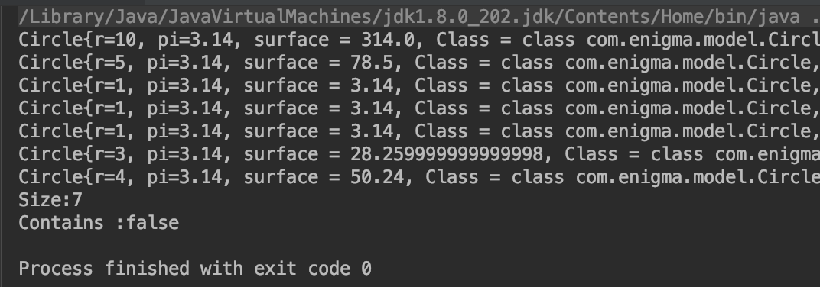
List-Arraylist
Text
public class Main {
public static void main(String[] args) throws IOException, InterruptedException {
List<Circle> circleList = new ArrayList<>();
circleList.add(new Circle(10));
circleList.add(new Circle(5));
circleList.add(new Circle(1));
circleList.add(new Circle(1));
circleList.add(new Circle(1));
circleList.add(new Circle(3));
circleList.add(new Circle(4));
for (Circle circle: circleList) {
System.out.println(circle.print());
}
System.out.println("Size:"+circleList.size());
Circle findRings = new Circle(3);
System.out.println("Contains :"+circleList.contains(findRings));
}
}
public class Circle extends Shape {
private Integer r;
private final Double pi=3.14;
public Circle(Integer r) {
this.r = r;
}
@Override
public Double getSurface(){
Double surface = pi*r*r;
return surface;
}
@Override
public Double getRound(){
Double round = pi*r*2;
return round;
}
@Override
public int hashCode() {
return Objects.hash(r);
}
public String print() {
return "Circle{" + "r=" + r +
", pi=" + pi +
", surface = "+getSurface()+
", Class = "+getClass()+
", round = "+getRound()+'}';
}
}
Try to find circles with r=3
Not Found

Slide 56
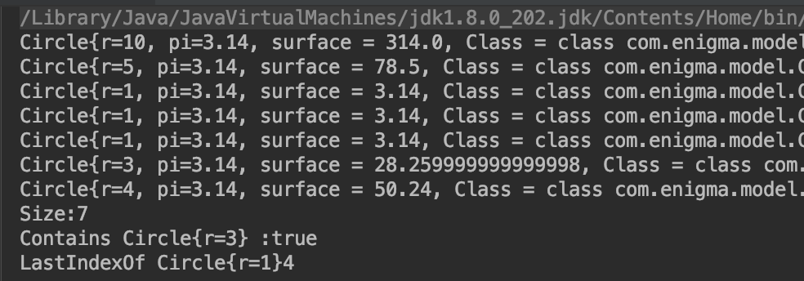
Text
public class Main {
public static void main(String[] args) throws IOException, InterruptedException {
List<Circle> circleList = new ArrayList<>();
circleList.add(new Circle(10));
circleList.add(new Circle(5));
circleList.add(new Circle(1));
circleList.add(new Circle(1));
circleList.add(new Circle(1));
circleList.add(new Circle(3));
circleList.add(new Circle(4));
for (Circle circle: circleList) {
System.out.println(circle.print());
}
System.out.println("Size:"+circleList.size());
System.out.println("Contains Circle{r=3} :"+circleList.contains(new Circle(3)));
System.out.println("LastIndexOf Circle{r=1}"+circleList.lastIndexOf(new Circle(1)));
}
}
public class Circle extends Shape {
private Integer r;
private final Double pi=3.14;
public Circle(Integer r) {
this.r = r;
}
@Override
public Double getSurface(){
Double surface = pi*r*r;
return surface;
}
@Override
public Double getRound(){
Double round = pi*r*2;
return round;
}
@Override
public boolean equals(Object o) {
if (this == o) return true;
if (o == null || getClass() != o.getClass()) return false;
Circle circle = (Circle) o;
return Objects.equals(r, circle.r);
}
@Override
public int hashCode() {
return Objects.hash(r);
}
public String print() {
return "Circle{" + "r=" + r +
", pi=" + pi +
", surface = "+getSurface()+
", Class = "+getClass()+
", round = "+getRound()+'}';
}
}
After we add equals() method

Slide 57
Exception

Slide 58
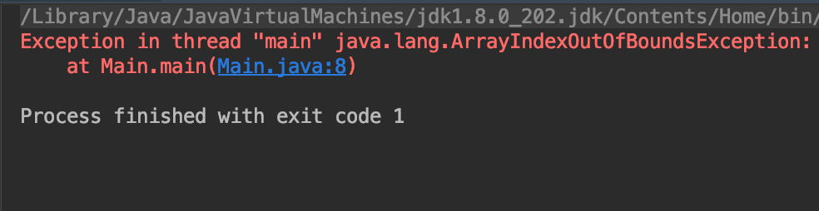
Lets make some error
Text
public class Main {
public static void main(String[] args) {
int [] setOfNumber = {2,5,6,3};
System.out.println(setOfNumber[4]);
}
}
IDE seems fine !!
This sh*t happens During RunTime

Slide 59
Exception
Text
Calm down, these is just a few example.
THE WHOLE SH*T IS MUCH MORE

Slide 60
Text
Would you try to catch it, or just throw it?
Always prepare for the worst!!
Angga Raditya

Slide 61
How to handle it?
Text
public static void main(String[] args) throws ArrayIndexOutOfBoundsException {
int [] setOfNumber = {2,5,6,3};
System.out.println(setOfNumber[4]);
}
Throw it
Hints : when you throw from the main method (psvm) the JVM will catch it
public static void main(String[] args) {
try{
int [] setOfNumber = {2,5,6,3};
System.out.println(setOfNumber[4]);
}catch (ArrayIndexOutOfBoundsException e){
}
}
Catch it

Slide 62
File

Slide 63
What if
Text
You want to save your robot’s last position
You want to save your heroes current hp
You want to save you current level in you favourite console game

Slide 64
Text
Your variables will disappear as soon as your application stop running
Angga Raditya

Slide 65
Lets back to your hardware
Text

Slide 66
You want to save all those informations permanently in this f*cking box as aFILE

Slide 67
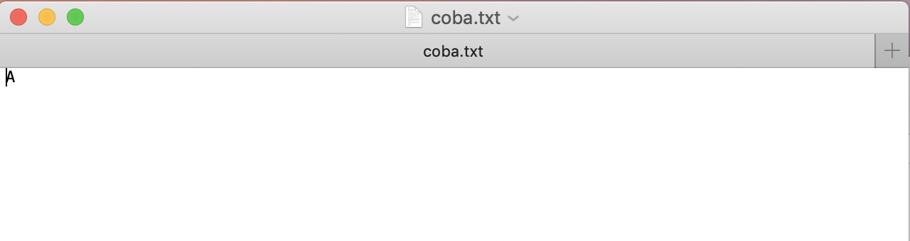
FileOutputstream
Text
public class Main {
final static File fileCoba = new File("/Users/anggaraditya/coba.txt");
public static void main(String[] args) {
try {
FileOutputStream fos = new FileOutputStream(fileCoba);
fos.write(65);
fos.close();
} catch (IOException e) {
e.printStackTrace();
}
}
}
?

Slide 68
Fileoutputstream
Text

Slide 69
Fileoutputstream
Text
It the basic writer in Java IO
It can write only a byte or a char with an ascii code

Slide 70
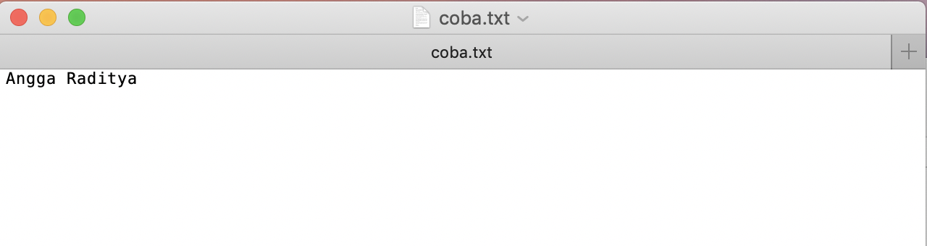
FIlewriter
Text
public class Main {
final static File fileCoba = new File("/Users/anggaraditya/coba.txt");
public static void main(String[] args) {
try {
FileWriter fw = new FileWriter(fileCoba);
fw.write("Angga Raditya");
fw.close();
} catch (IOException e) {
e.printStackTrace();
}
}
}

Slide 71
fileWriter
Text
It use FileOutputStream
It gives you few feature sa: write(String);
But still, it only append(Char )
Hints : find out write() and append() usage

Slide 72
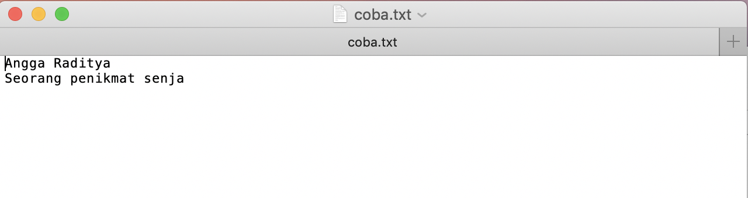
Bufferedwriter
Text
public class Main {
final static File fileCoba = new File("/Users/anggaraditya/coba.txt");
public static void main(String[] args) {
try {
BufferedWriter fw = new BufferedWriter(new FileWriter(fileCoba,true));
fw.newLine();
fw.append("Seorang penikmat senja");
fw.close();
} catch (IOException e) {
e.printStackTrace();
}
}
}

Slide 73
Bufferedwriter
Text
It use FileWriter
I guess you can find out by yourself

Slide 74
The READER
Text
FileOutputStream
FileInputStream
FileWriter
FileReader
BufferedWriter
BufferedReader
Penulis
Pembaca

Slide 75
public void read() {
try {
FileInputStream fileInputStream = new FileInputStream(fileCoba);
while (true){
int ascii = fileInputStream.read();
if(ascii==-1) break;
System.out.println( (char) ascii );
}
} catch (FileNotFoundException e) {
e.printStackTrace();
} catch (IOException e) {
e.printStackTrace();
}
}
public void read() {
try {
FileReader fileReader = new FileReader(fileCoba);
while (true){
int ascii = fileReader.read();
if(ascii==-1) break;
System.out.println( (char) ascii );
}
} catch (FileNotFoundException e) {
e.printStackTrace();
} catch (IOException e) {
e.printStackTrace();
}
}
public void read() {
try {
BufferedReader bufferedReader = new BufferedReader(new FileReader(fileCoba));
while (true){
String text = bufferedReader.readLine();
if(text==null) break;
System.out.println(text);
}
} catch (FileNotFoundException e) {
e.printStackTrace();
} catch (IOException e) {
e.printStackTrace();
}
}

Slide 76
TEST DRIVEN DEVELOPMENT
( tdd )

Slide 77
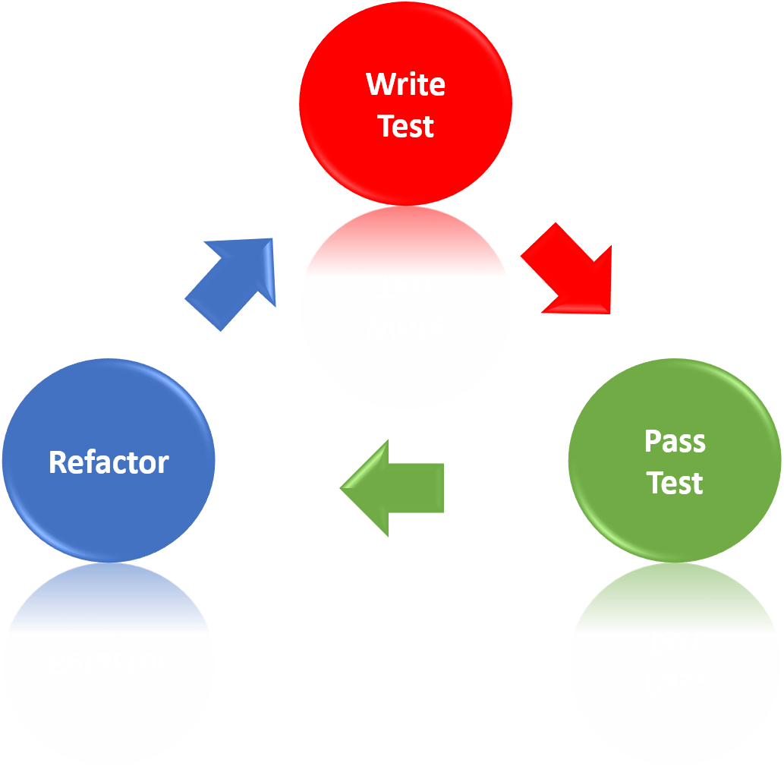
WHAT IS’T TDD ??
The cycles of TDD :
TDD is a very simple but powerful technique. It consists of 3 steps:
Write a minimal test, which fails (red)
Write the minimal code to fulfill the test (green)
Refactor (green)

Slide 78
“ I can't image writing code without having a test first
anymore. ”

Slide 79
Minimal test
If you want to know the available space in parking area.
2. MINIMAL CODE
Sticking to our above example of to the available space in parking area, then you must count the number of parking slots in the area when there are no cars parked.
3. REFACTOR
Never change both at the same time. And the only other condition is: Do not break anything.

Slide 80
JUnit …
JUnit is a test framework which uses annotations to identify methods that specify a test in java.
How to Define a test in JUnit ??
A JUnit test is a method contained in a class which only used for the testing. This is called a Test class. To define that a certain method is a test method, annotate it with @TEST annotation.

Slide 81
What is Junit Assert?
Assert is a method useful in determining Pass or Fail status of a test case.
Assert Equals
If you want to test equality of two objects, you have the following methods
assertEquals(expected, actual)
It will return true if: expected.equals( actual ) returns true.

Slide 82
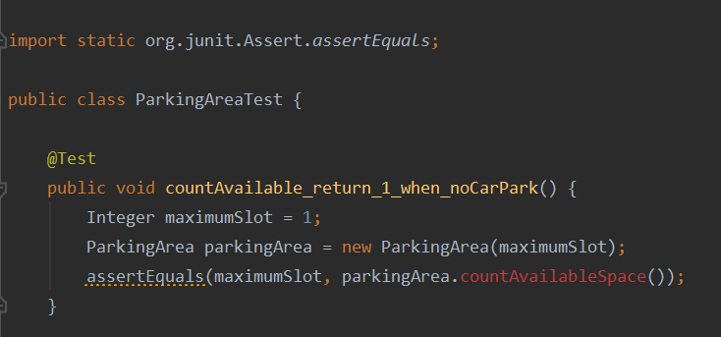
Example JUnit test
What ? This is an error guys -_-

Slide 83
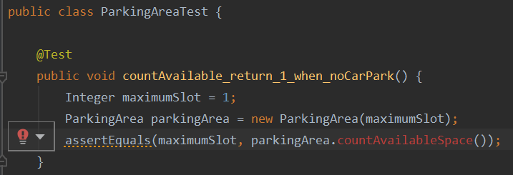
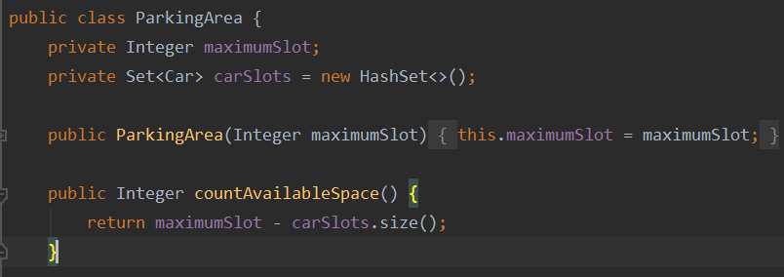
The solution is ..
Click, and create a method.

Slide 84
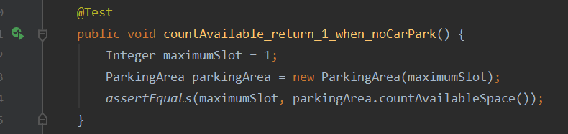
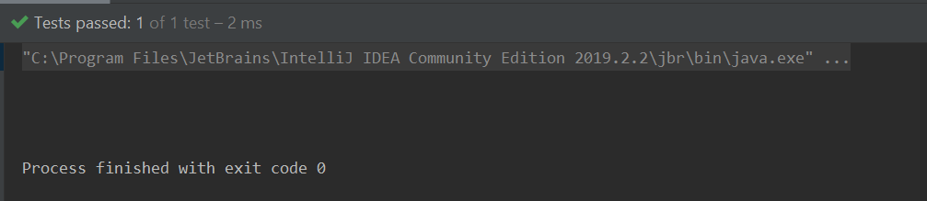
For check the test case :

Slide 85
7 Popular Unit Test Naming Conventions
MethodName_StateUnderTest_ExpectedBehavior
MethodName_ExpectedBehavior_StateUnderTest
test[Feature being tested]
Feature to be tested
Should_ExpectedBehavior_When_StateUnderTest
When_StateUnderTest_Expect_ExpectedBehavior
Given_Preconditions_When_StateUnderTest_Then_ExpectedBehavior:

